Slide 1
System Development Life Cycle (SDLC) & use of CASE Tools
Systems Analysis and Design

Slide 2
Learning Objectives
Know the steps of the SDLC & how to apply it to real systems.
Understand System Dev’t methodologies
Understand what CASE tools are & how they help a systems Analyst.
Get an overview of Object-oriented SAD.
1-<number>

Slide 3
Systems Development Life Cycle
The systems development life cycle is a systematic approach to solving business problems.
It is divided into seven phases.
Each phase has unique activities.
1-<number>

Slide 4
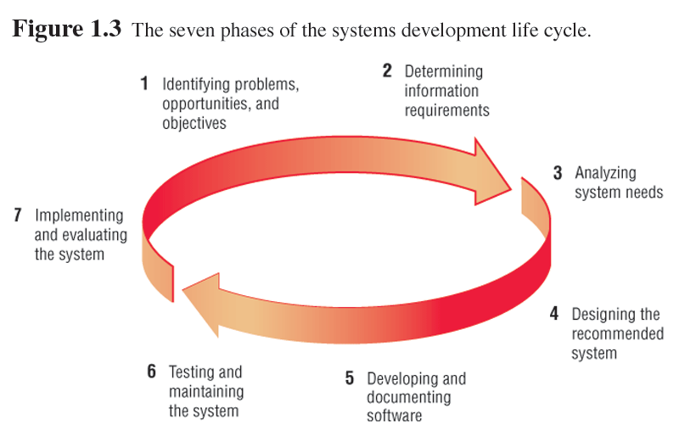
1-<number>

Slide 5
System Dev’t Projects:
Problem – an undesirable situation that prevents the organization from fully achieving its purpose, goals, and/or objectives.
Opportunity – a chance to improve the organization even in the absence of an identified problem.
Directive - a new requirement that is imposed by management, government, or some external influence.
1-<number>

Slide 6
Phase 1
Identifying:
  Problems.
  Opportunities.
  Objectives.
Personnel involved:
  Analyst.
  User management.
  Systems management.
1-<number>

Slide 7
Problem Solving Frame-work:
P the need to improve performance
I the need to improve information (and data)
E the need to improve economics, control costs, or increase profits
C the need to improve control or security
E the need to improve efficiency of people and processes
S the need to improve service to customers, suppliers, partners, employees, etc.
1-<number>

Slide 8
Phase 2
Determining information requirements:
  Interview management, operations personnel.
  Gather systems/operating documents.
  Use questionnaires.
  Observe the system and personnel involved.
Learn the who, what, where, when, and how, and the why for each of these.
Fiona C. Ssozi - Mugarura
1-<number>

Slide 9
Phase 2 (Continued)
Personnel involved:
  Analyst.
  User management.
  User operations workers.
  Systems management.
Fiona C. Ssozi - Mugarura
1-<number>

Slide 10
Phase 3
Analyzing system needs:
  Create data flow diagrams.
  Document procedural logic for data flow diagram processes.
  Complete the data dictionary.
  Make semistructured decisions.
  Prepare and present the system proposal.
  Recommend the optimal solution to management.
Fiona C. Ssozi - Mugarura
1-<number>

Slide 11
Phase 3 (Continued)
Personnel involved:
  Analyst.
  User management.
  Systems management.
1-<number>

Slide 12
Phase 4
Designing the recommended system:
  Design the user interface.
    Design output.
    Design input.
  Design system controls.
  Design files and/or database.
  Produce program specifications.
  Produce decision trees or tables.
1-<number>

Slide 13
Phase 4 (Continued)
Personnel involved:
  Analyst.
  System designer.
  User management.
  User operations workers.
  Systems management.
1-<number>

Slide 14
Phase 5
Developing and documenting software:
  Design computer programs using structure charts and pseudocode.
  Walkthrough program design.
  Write computer programs.
  Document software with help files, procedure manuals, and Web sites with Frequently Asked Questions.
1-<number>

Slide 15
Phase 5 (Continued)
Personnel involved:
  Analyst.
  System designer.
  Programmers.
  Systems management.
1-<number>

Slide 16
Phase 6
Testing and maintaining the system:
  Test and debug computer programs.
  Test the computer system.
  Enhance system.
1-<number>

Slide 17
Phase 6 (Continued)
Personnel involved:
  Analyst.
  System designer.
  Programmers.
  Systems management.
1-<number>

Slide 18
Phase 7
Implementing and evaluating the system:
  Plan conversion.
  Train users.
  Purchase and install new equipment.
  Convert files.
  Install system.
  Review and evaluate system.
1-<number>

Slide 19
Phase 7 (Continued)
Personnel involved:
  Analyst.
  System designer.
  Programmers.
  User management.
  User operations workers.
  Systems management.
1-<number>

Slide 20
System Maintenance
System maintenance is:
  Removing undetected errors, and
  Enhancing existing software.
Time spent on maintenance typically ranges from 48-60 percent of total time.
1-<number>

Slide 21
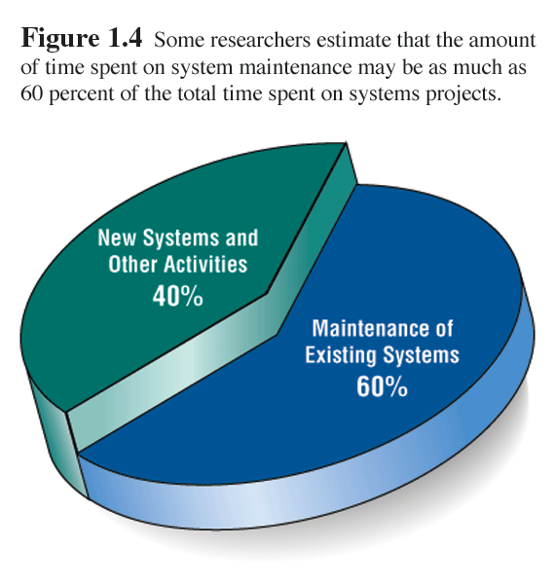
1-<number>

Slide 22
System Enhancements
Systems are enhanced for the following reasons:
  Adding additional features to the system.
  Business and governmental requirements change over time.
  Technology, hardware, and software are rapidly changing.
1-<number>

Slide 23
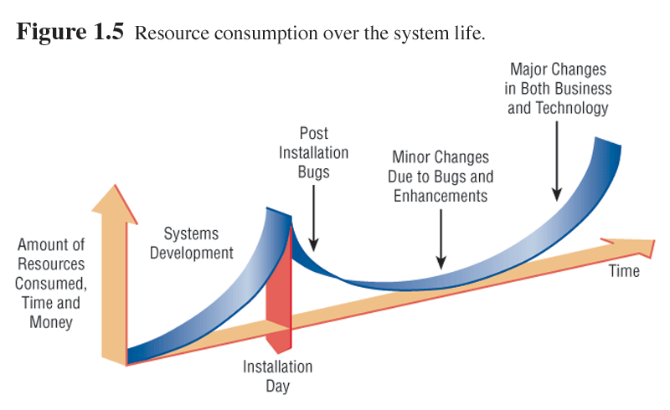
1-<number>

Slide 24
System Dev’t Methodologies:
standardized development procedures that define (as in CMM Level 3) a set of activities, methods, best practices, deliverables, and automated tools that system developers and project managers use to develop and continuously improve information systems and software.
1-<number>

Slide 25
System Dev’t Methodologies:
Architected Rapid Application Development (Architected RAD)
Dynamic Systems Development Methodology (DSDM)
Joint Application Development (JAD)
Information Engineering (IE)
Rapid Application Development (RAD)
Rational Unified Process (RUP)
Structured Analysis and Design
eXtreme Programming (XP)
1-<number>

Slide 26
Rapid Application Development
Rapid Application development (RAD) is an object-oriented approach to systems development.
emphasizes speed of development through extensive user involvement in the rapid, iterative, and incremental construction of series of functioning prototypes of a system that eventually evolves into the final system.
  Prototype – a small-scale, representative, or working model of the users’ requirements or a proposed design for an information system.
1-<number>

Slide 27
CASE Tools
  CASE tools are automated, microcomputer-based software packages for systems analysis and design.
  Four reasons for using CASE tools are:
    To increase analyst productivity.
    Facilitate communication among analysts and users.
    Providing continuity between life cycle phases.
    To assess the impact of maintenance.
1-<number>

Slide 28
CASE Tools
Computer-aided systems engineering (CASE) – the use of automated software tools that support the drawing and analysis of system models and associated specifications. Some CASE tools also provide prototyping and code generation capabilities.
  CASE repository – a system developers’ database where developers can store system models, detailed descriptions and specifications, and other products of system development. Synonyms include dictionary and encyclopedia.
  Forward engineering – a CASE tool capability that can generate initial software or database code directly from system.
  Reverse engineering – a CASE tool capability that can generate initial system models from software or database code.
1-<number>

Slide 29
CASE Tool Categories
CASE tools may be divided into several categories
  Upper CASE (also called front-end CASE) tools, used to perform analysis and design.
  Lower CASE (also called back-end CASE). These tools generate computer language source code from CASE design.
  Integrated CASE, performing both upper and lower CASE functions.
1-<number>

Slide 30
Upper CASE
Upper CASE tools:
  Create and modify the system design.
  Store data in a project repository.
  The repository is a collection of records, elements, diagrams, screens, reports, and other project information.
  These CASE tools model organizational requirements and define system boundaries.
1-<number>

Slide 31
Lower CASE
Lower CASE tools generate computer source code from the CASE design.
Source code may usually be generated in several languages.
1-<number>

Slide 32
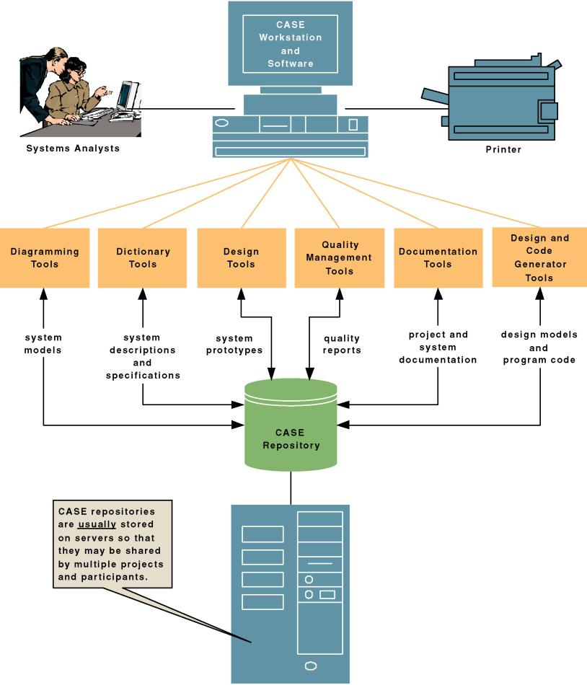
CASE Tool Architecture:
1-<number>

Slide 33
Advantages of Generating Code
  Time to develop new systems decreases.
  The time to maintain generated code is less than to maintain traditional systems.
  Computer programs may be generated in more than one language.
  CASE design may be purchased from third-party vendors and tailored to organizational needs.
  Generated code is free from program coding errors.
1-<number>

Slide 34
1-<number>

Slide 35
Reverse Engineering
Reverse engineering is generating the CASE design from computer program code.
Source code is examined, analyzed, and converted into repository entities.
1-<number>

Slide 36
Reverse Engineering (Continued)
Reverse engineering produces (depending on the tool set used):
  Data structures and elements, describing the files, records, and field.
  Screen designs, if the program is online.
  Report layouts for batch programs.
  A structure chart showing the hierarchy of the modules in the program.
  Database design and relationships.
1-<number>

Slide 37
Advantages of Reverse Engineering
Reverse Engineering has the following advantages:
  Reduced system maintenance time.
  Program documentation is produced for loosely documented programs.
  Structured programs may be generated from unstructured, older programs.
  Future system maintenance is easier to implement.
  Unused portions of programs may be eliminated.
1-<number>

Slide 38
Object-Oriented Analysis and Design
Object-oriented (O-O) analysis and design is used to build object-oriented programs.
O-O programming examines the objects of a system.
Objects are grouped into classes for optimal reuse and maintainability.
1-<number>

Slide 39
The Unified Modeling Language
The Unified Modeling Language (UML) is an industry standard for modeling object-oriented systems.
It breaks down a system into a use case model.
1-<number>

Slide 40
Extreme Programming (XP)
Extreme programming takes good software development practices and pushes them to the limit.
It is based on:
  Values.
  Principles.
  Core practices.
1-<number>

Slide 41
Extreme Programming (XP) (Continued)
Extreme programming values are:
  Communication.
  Simplicity.
  Feedback.
  Courage.
1-<number>

Slide 42
Alternate Methodologies
Alternate methodologies are available for analyzing systems.
These include:
  Prototyping.
  ETHICS.
  Project Champions.
  Soft Systems Methodology.
  Multi-view.
1-<number>

Slide 43
Principles of Systems Dev’t
Get the system users involved.
Use a problem-solving approach.
Establish phases and activities.
Document through development.
Establish standards.
Manage the process and projects
Justify systems as capital investments.
Don’t be afraid to cancel or revise scope.
Divide and conquer.
Design systems for growth and change.
1-<number>

